Slide 1

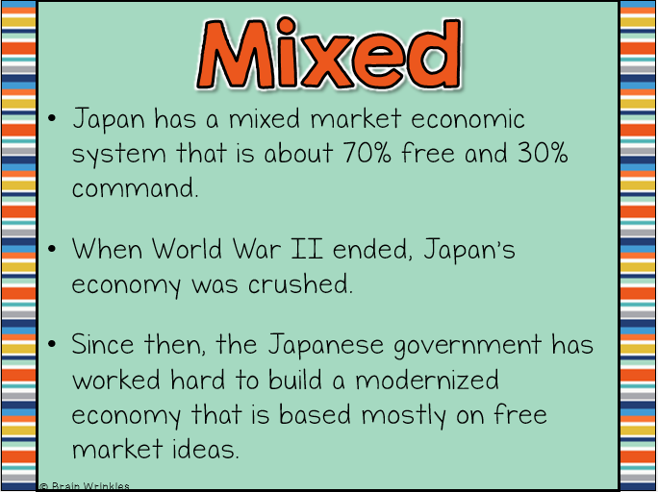
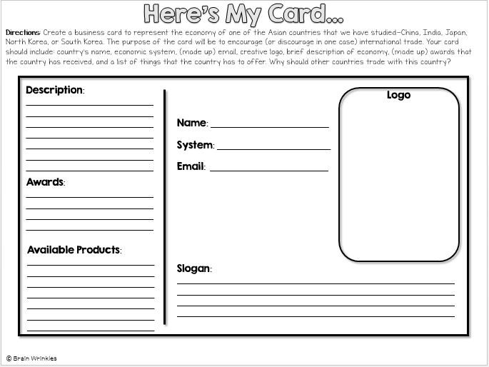
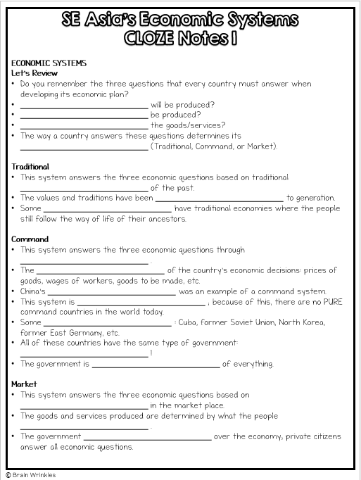
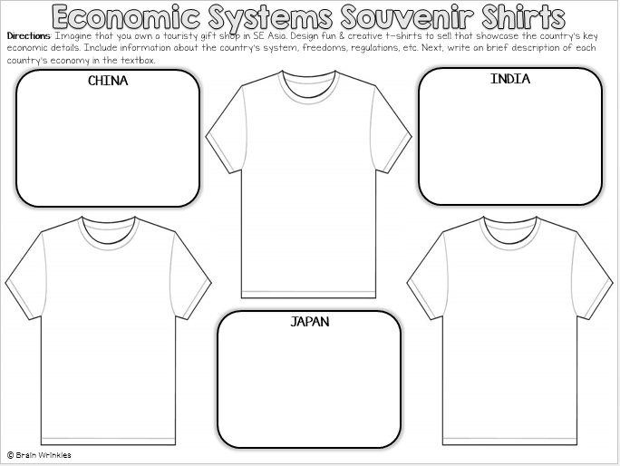

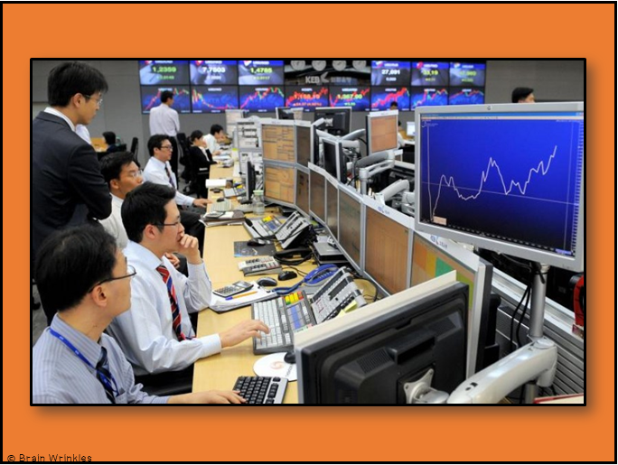
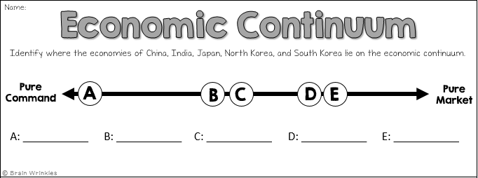
Southern & Eastern Asia’s
ECONOMIC
SYSTEMS
ECONOMIC
SYSTEMS

Slide 2
STANDARDS:
SS7E7 Analyze different economic systems.
Compare how traditional, command, and market economies answer the economic questions of 1-what to produce, 2-how to produce, and 3-for whom to produce.
Explain that countries have a mixed economic system located on a continuum between pure market and pure command.
Compare and contrast the economic systems in China, India, Japan, North Korea, and South Korea.
© Brain Wrinkles

Slide 3

Southern & Eastern Asia’s
ECONOMIC
SYSTEMS
China, India, Japan, North Korea, & South Korea
© Brain Wrinkles

Slide 4
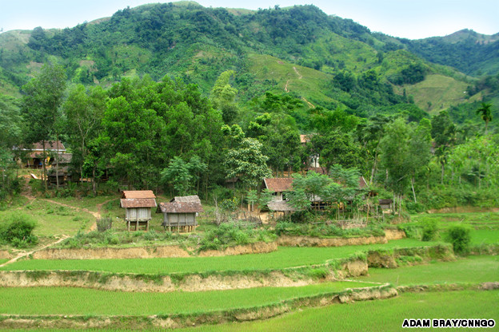
Rice Village in SE Asia - Traditional Economy
© Brain Wrinkles

Slide 5
SE Asia
Most countries in Southern and Eastern Asia have mixed economies; however many of them have a high level of government involvement that leans closer to command than to market.
Strictly-controlled prices and government-owned industries are common throughout the region, especially in China and North Korea.
On the other hand, the region also has some countries with very free economies, like South Korea and Japan.
© Brain Wrinkles

Slide 6
CHINA
© Brain Wrinkles

Slide 7
Mixed
China has a mixed economic system that is about 57% free and 43% command.
China is transitioning from a command economy controlled by the communist Chinese government, towards a mixed market one with more economic freedom for individuals.
Since China started loosening up the centrally planned economy in the 1970s, private companies have produced much more of China’s growth.
© Brain Wrinkles

Slide 8
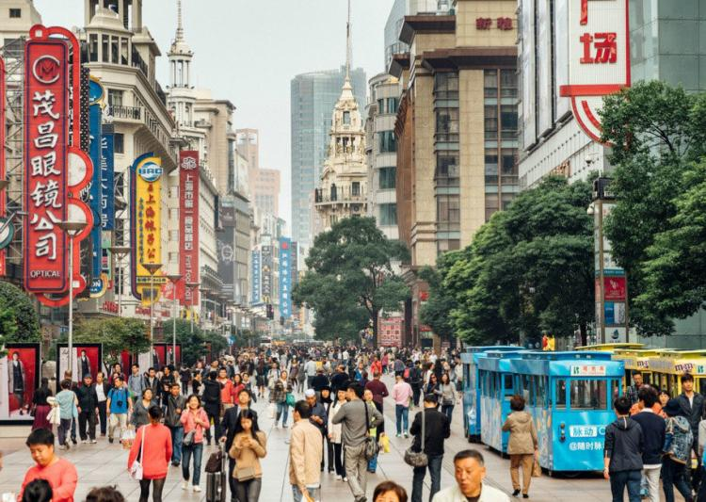
© Brain Wrinkles

Slide 9
Growth
China’s economy is the fastest-growing economy in the world, as well as the largest economy in the world.
Economists predict that within the next twenty years, China will lead the world in economic strength.
© Brain Wrinkles

Slide 10
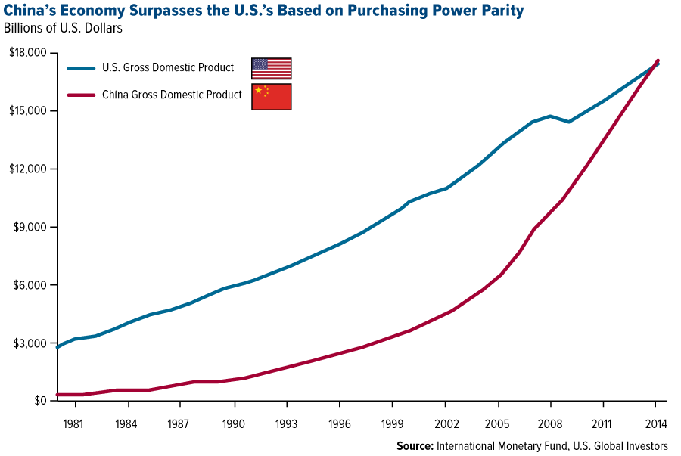
© Brain Wrinkles

Slide 11
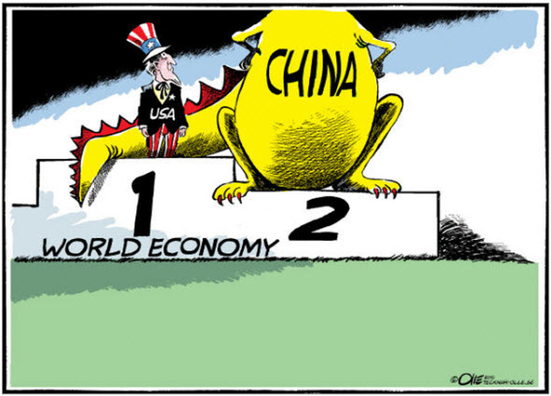
© Brain Wrinkles

Slide 12
Freedom
Throughout the past several decades, China has transitioned away from a centrally-planned command economy and is moving more towards a free market one.
China’s national government has let more and more citizens and private corporations take over industries that it previously owned.
The government has also allowed farmers to make their own decisions regarding crops, rather than collectively farm.
© Brain Wrinkles

Slide 13
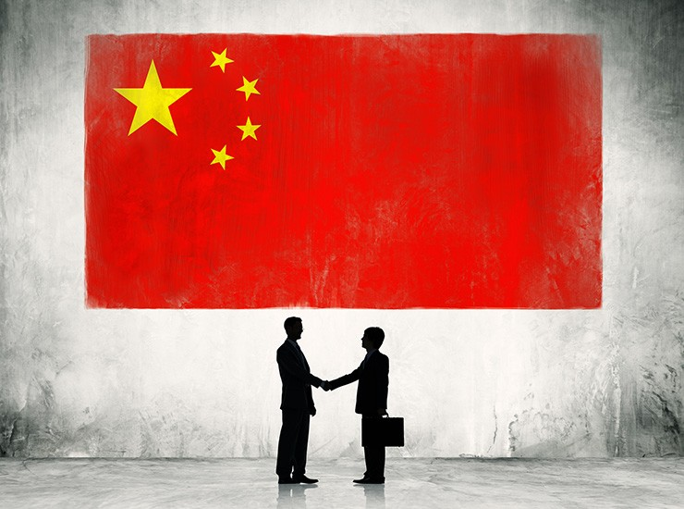
© Brain Wrinkles

Slide 14
Freedom
The government has loosened its control and now encourages competition among businesses, which has helped the economy grow.
Today, Chinese companies have more power to set prices of their goods based on supply and demand of the market.
China’s government has also allowed businesses to raise their own money through investments made in a stock market.
© Brain Wrinkles

Slide 15
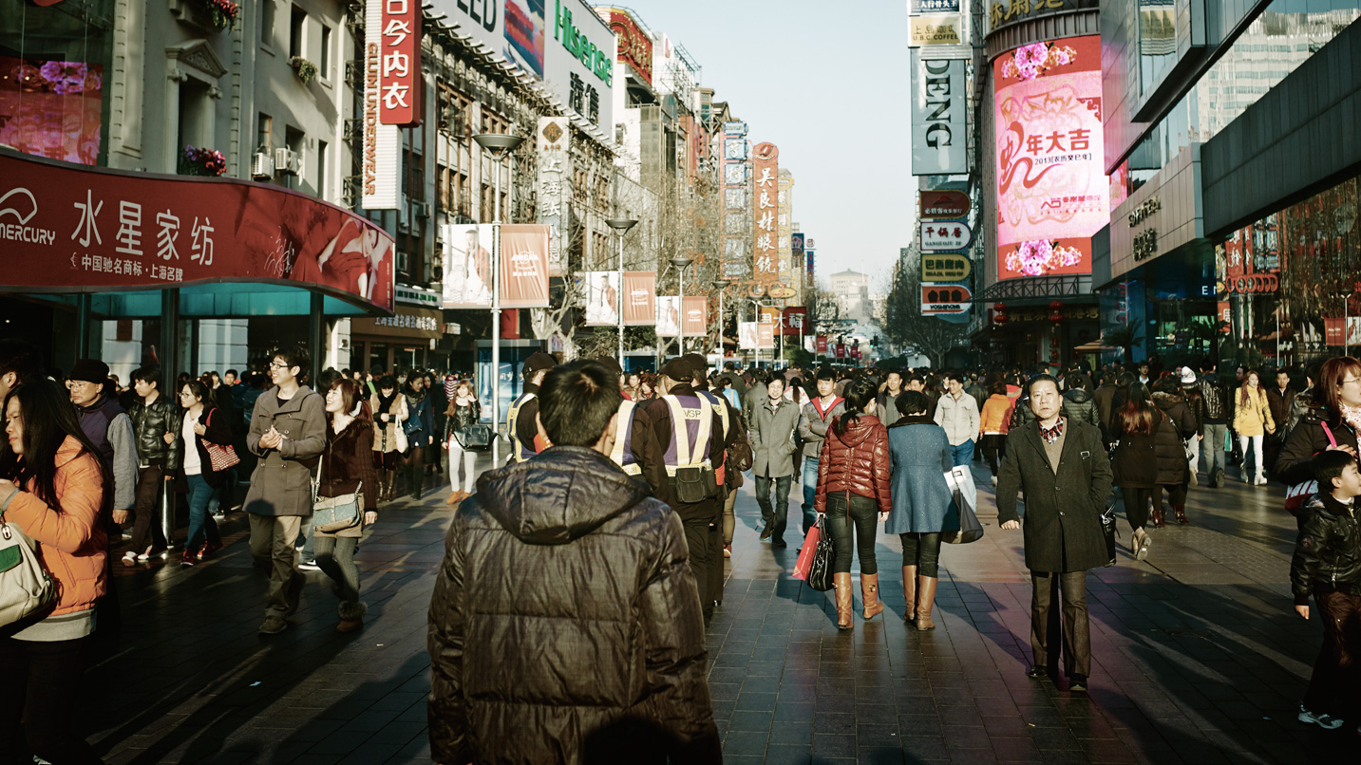
© Brain Wrinkles

Slide 16
Regulation
While private enterprise is playing a larger role in China’s economy, the national government is still extremely influential in the country’s economic planning.
The biggest companies in China are all state-owned.
The government operates industries like banking, oil, airlines, and telecommunications.
It also charges high taxes in order to pay for infrastructure and social services.
© Brain Wrinkles

Slide 17
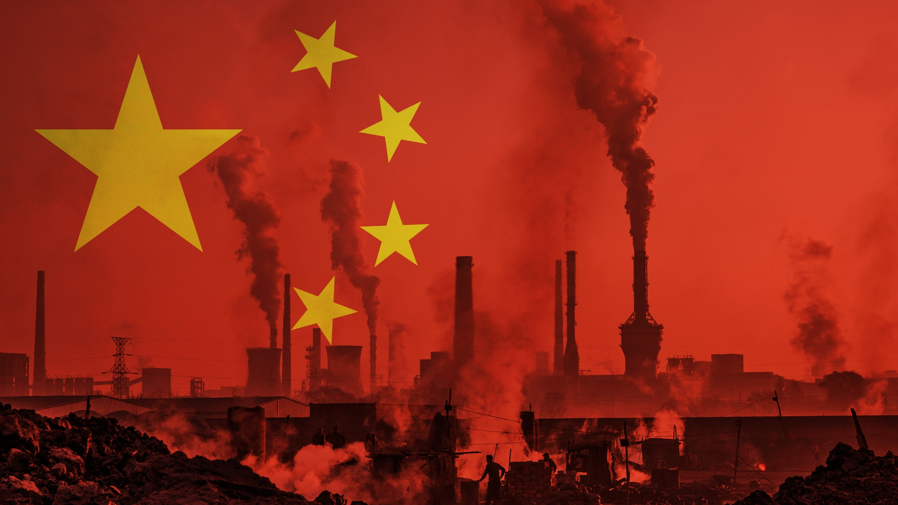
© Brain Wrinkles

Slide 18
INDIA
© Brain Wrinkles

Slide 19
Mixed
India has a mixed economic system that is about 53% free and 47% command.
When India gained independence in 1947, its government set up a command economy and controlled all industries and production.
Since the early 1990s, the government loosened some of its control and has allowed private businesses to participate in the economy.
© Brain Wrinkles

Slide 20
Freedom
Over the past thirty years, India’s national government has let more and more citizens and private corporations take over industries that it used to own.
Private businesses now have the ability to decide how much of a good to produce and to set their own prices.
In addition, in order to promote entrepreneurship, the government provides support to new business owners with training, facilities, and loans to get started.
© Brain Wrinkles

Slide 21
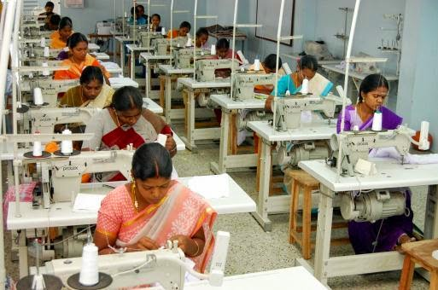
Small-scale Garment Factory in India
© Brain Wrinkles

Slide 22
Growth
Since the government has loosened its control , India’s economy has been growing rapidly and is now ranked the 7th-largest economy in the world.
Because of its large, educated population, India has developed prosperous information technology and software services industries.
Unfortunately, although the transition from a command to a more market system has been good for India’s economy, millions of Indians still live in poverty.
© Brain Wrinkles

Slide 23
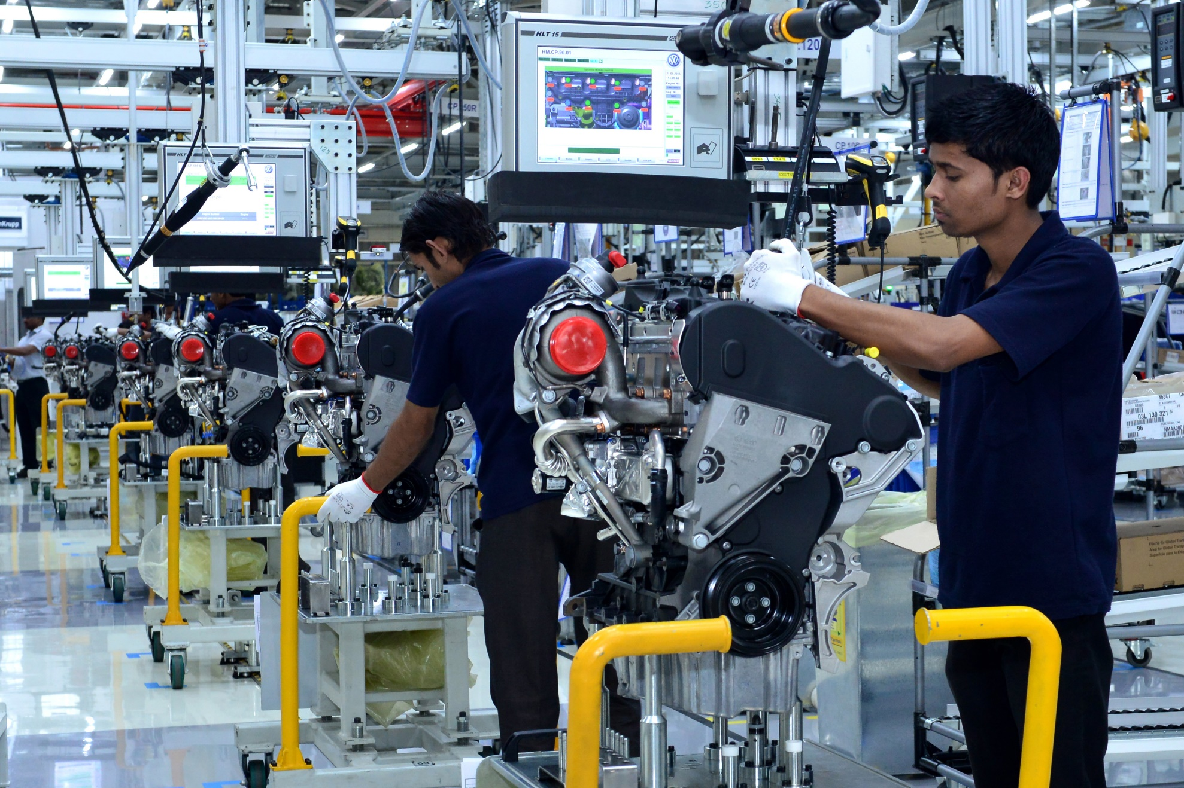
Engineering Technology Education in India
© Brain Wrinkles

Slide 24
Regulation
India’s government is still very active in its economy.
The government imposes high taxes on private businesses, subsidies on goods in the private sector, and tariffs on imported goods.
A number of industries are state-run, while the government is partially involved in others.
Strict government regulations make economic growth difficult.
© Brain Wrinkles

Slide 25
JAPAN
© Brain Wrinkles

Slide 26
Mixed
Japan has a mixed market economic system that is about 70% free and 30% command.
When World War II ended, Japan’s economy was crushed.
Since then, the Japanese government has worked hard to build a modernized economy that is based mostly on free market ideas.
© Brain Wrinkles

Slide 27

© Brain Wrinkles

Slide 28
Freedom
In Japan’s mixed market economy, private businesses and individuals have the ability to set their own prices and to decided how much to produce based on supply and demand.
Japanese businesses and citizens own much of the land, resources, and factories.
© Brain Wrinkles

Slide 29
Regulation
Japan’s government owns few companies other than the country’s major television network, but it does regulate some aspects of the economy like banking and trade.
It also imposes taxes on businesses and citizens and places quotas or tariffs on imports.
Japan’s government also screens foreign investments, which foreign governments have complained about for many years.
© Brain Wrinkles

Slide 30
NORTH
KOREA
© Brain Wrinkles

Slide 31
Command
North Korea’s economy is only 5% free and 95% controlled.
Economists say it is a fully command economic system.
North Korea’s economy is the most government-controlled and repressed in the world.
© Brain Wrinkles

Slide 32
Freedom?
Private businesses and citizens have no real role in North Korea’s economy.
In fact, entrepreneurship is considered illegal.
The Communist central government makes all economic decisions about what to produce, how much to charge, and for whom.
© Brain Wrinkles

Slide 33
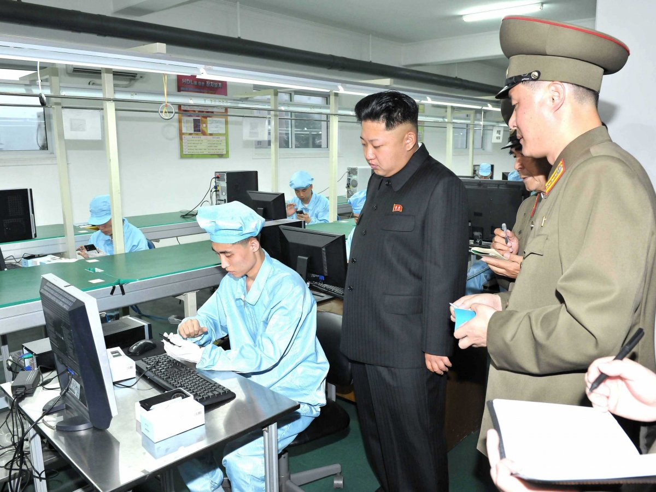
North Korean Factory Inspection
© Brain Wrinkles

Slide 34
Regulation
North Korea’s government regulates its economy without any input from private citizens.
It controls how food is distributed to the people.
It owns almost all property and resources.
The government also blocks almost all foreign businesses from investing (or helping).
© Brain Wrinkles

Slide 35
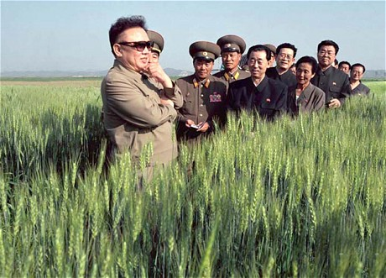
Farm Inspection
© Brain Wrinkles

Slide 36
Growth?
Having so much government control has not allowed North Korea’s economy to grow or innovate.
North Korea has not had positive economic growth since the early 1990s.
The country’s agriculture does not produce enough to feed the population, so the country is forced to receive aid from other countries in order to avoid famine.
© Brain Wrinkles

Slide 37
Growth?
Factories, machinery, and equipment are severely outdated because the government has invested heavily in the military rather than the economy.
North Korea would not be prepared to join the world economy even if other countries wanted it to.
Most countries (other than China) refuse to trade with North Korea because of its strict government and history of aggression.
© Brain Wrinkles

Slide 38
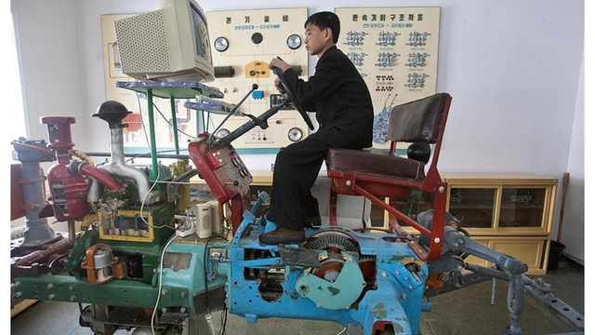
Outdated Tractor Simulator –
How North Korea trains future farmers.
© Brain Wrinkles

Slide 39
SOUTH
KOREA
© Brain Wrinkles

Slide 40
Mixed
South Korea has a mixed economic system that is about 74% free and 26% command.
In the 1970s, South Korea’s democratic government partnered with private companies on economic decisions.
  This has led to rapid economic growth for South Korea.
Today, the country has a highly industrialized economy that leans towards a free market system.
© Brain Wrinkles

Slide 41
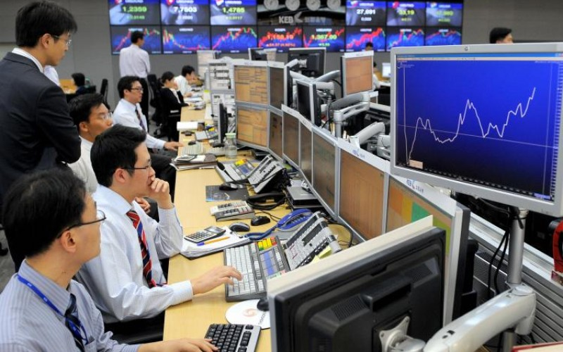
© Brain Wrinkles

Slide 42
Freedom
Private businesses and citizens have played a large role in the growth of South Korea’s economy.
They are able to set prices and decide how much to produce based on supply and demand without much government interference.
South Korea’s government supports entrepreneurship, and overall business freedom ranks at 91%.
© Brain Wrinkles

Slide 43
Regulation
In order to pay for state services and infrastructure, South Korea’s government charges taxes on businesses and citizens.
Even though most of the former state-run industries have privatized, the government still runs the real estate, energy, railroad, and road construction sectors.
© Brain Wrinkles

Slide 44
TEACHER INFO:
Print off the chart below for each student.
They should complete the charts after discussing the presentation.
Check answers as a class when finished.
© Brain Wrinkles

Slide 45
Southern and Eastern Asia’s Economic Systems
Directions: Complete the chart below with information that you learned during the presentation.
 | Economic System | Freedoms | Regulations | Growth
China
India
Japan
North Korea
South Korea
© Brain Wrinkles

Slide 46
Southern and Eastern Asia’s Economic Systems
Directions: Complete the chart below with information that you learned during the presentation.
 | Economic System | Freedoms | Regulations | Growth
China | Mixed, moving away from command | More private companies are taking over formerly state-owned businesses, farmers can make own decisions now, there is now a stock market | Government is still influential, biggest companies are all state-run, high taxes | Fastest-growing economy
India | Mixed, moving away from command | Has loosened control since 1990s, private citizens can make some decisions about setting prices and how much, gov promotes entrepreneurship | Gov is still very active: high taxes, uses tariffs, subsidizes goods in private sector, run a lot of industries & is partially involved in others | Economy is growing rapidly, 7th largest in the world, prosperous technology sector
Japan | Mixed, closer towards market than command | Individuals set prices & decided what/how much to produce; citizens own much o the land, resources, & factories | Gov owns few companies; uses tariffs and has taxes, screens foreign investments | Grown steadily since WWII ended;; modernized economy
North Korea | Closest country in the world to a pure command economy | No economic freedoms for private citizens or businesses | Government makes all economic decisions and owns all property and resources | No positive economic growth since the 1990s
South Korea | Mixed, closer towards market than command | Citizens have large role: set prices & choose how much to produce; entrepreneurship is encouraged | Gov charges taxes on businesses, gov stil runs a few industries | In 1970s, gov partnered with private companies on economic decisions which has led to rapid economic growth, highly industrialized economy today
© Brain Wrinkles

Slide 47
TEACHER INFO: Souvenir Shirts
Pass out the Souvenir Shirts handout to each student. (Print front-to-back to save paper.)
The students will create t-shirts to showcase each country’s key economic details. The shirts should include symbols and images that represent the country’s system, freedoms, regulations, etc.
The students will also write a brief description of each country’s economy in the textbox.
© Brain Wrinkles

Slide 48
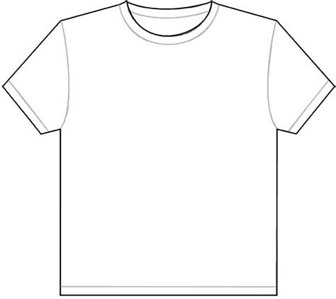
Economic Systems Souvenir Shirts
Directions: Imagine that you own a touristy gift shop in SE Asia. Design fun & creative t-shirts to sell that showcase each country’s key economic details. Include information about the country’s system, freedoms, regulations, etc. Next, write a brief description of each country’s economy in the textbox.
CHINA
INDIA
JAPAN
© Brain Wrinkles

Slide 49
Economic Systems Souvenir Shirts
NORTH KOREA
SOUTH KOREA
© Brain Wrinkles

Slide 50
TEACHER INFO: Here’s My Card
Print off the Here’s My Card handout for each student.
The students will create a business card that represents the economy of China, India, Japan, North Korea, or South Korea. (You could number the students off & then each person in the group will have a different country. At the end, they can share their cards with group members.)
The business cards will include: the country’s name, economic system, (made up) email, creative logo, brief description of economy, (made up) awards that the country has received, and a list of things that the country has to offer.
© Brain Wrinkles

Slide 51
Here’s My Card…
Directions: Create a business card to represent the economy of one of the Asian countries that we have studied-China, India, Japan, North Korea, or South Korea. The purpose of the card will be to encourage (or discourage in one case) international trade. Your card should include: country’s name, economic system, (made up) email, creative logo, brief description of economy, (made up) awards that the country has received, and a list of things that the country has to offer. Why should other countries trade with this country?
Description: ____________________________________________________________________________________________________________________________________________________________________________________________________
Logo
Name: __________________________
System: _________________________
Email: __________________________
Awards: ________________________________________________________________________________________________________________
Available Products: ____________________________________________________________________________________________________________________________________________________________________________________________________
Slogan: ____________________________________________________________________________________________________________________________________________________________________________________________________________________________________________________
© Brain Wrinkles

Slide 52
TEACHER INFO: Comprehension Check
Print off the Comprehension Check for each student. (Print front-to-back to save paper.)
After the lesson, have the students answer the questions. *This could also be used as a quiz.
© Brain Wrinkles

Slide 53
1. What are the three economic questions that every country must answer?
2. How does a command economic system answer the three economic questions?
3. Which country’s economy has the most government control out of all the countries in the world?
4. How are the three economic questions answered in a traditional economic system?
5. In a free market economy, what do private citizens and businesses base their economic decisions on?
6. What type of economic system do most democratic countries have?
7. Which country has the world’s fastest-growing economy?
8. Describe how China is moving from a command economic system towards a market one:
9. How has India moved from a command economy to a mixed economy in recent years?
10. China and India both have mixed economic systems that are moving away from command and more towards market. Why do you think these countries (and other governments with command economies) eventually begin to give up some of their control?
© Brain Wrinkles
SE Asian Economies
Comprehension Check

Slide 54
11. What type of economic system is found in Japan?
12. Describe South Korea’s economy:
13. Describe North Korea’s economy:
14. Which country does not belong? Explain. SOUTH KOREA JAPAN NORTH KOREA
15. Which country does not belong? Explain. CHINA INDIA JAPAN
16. In your opinion, what is the relationship between adding elements of a market system to a country’s economy and the country’s economic growth?
17. Based on what you’ve learned about each country’s economic system, in which country would your MOST like to live? Why?
18. Based on what you’ve learned about each country’s economic system, in which country would your LEAST like to live? Why?
© Brain Wrinkles
SE Asian Economies
Comprehension Check

Slide 55
1. What are the three economic questions that every country must answer?
What to produce, How to produce, and for whom to produce
2. How does a command economic system answer the three economic questions?
Government makes ALL economic decisions
3. Which country’s economy has the most government control out of all the countries in the world?
North Korea
4. How are the three economic questions answered in a traditional economic system?
Economic decisions are made based on customs and beliefs of the past
5. In a free market economy, what do private citizens and businesses base their economic decisions on?
Supply and demand of the marketplace
6. What type of economic system do most democratic countries have?
Mixed
7. Which country has the world’s fastest-growing economy?
China
8. Describe how China is moving from a command economic system towards a market one:
China’s government has given private companies more power, it has let farmers make economic decisions independently instead of in a collective, it has let businesses raise their own money in a stock market
9. How has India moved from a command economy to a mixed economy in recent years?
India’s government has been deregulating industries and letting private companies have more and more control over setting prices and deciding what to produce
10. China and India both have mixed economic systems that are moving away from command and more towards market. Why do you think these countries (and other governments with command economies) eventually begin to give up some of their control?
Answers will vary
© Brain Wrinkles
SE Asian Economies
Comprehension Check

Slide 56
© Brain Wrinkles
11. What type of economic system is found in Japan?
Mixed market
12. Describe South Korea’s economy: (mixed) lots of economic freedom to make decisions based on supply and demand, little government regulation
13. Describe North Korea’s economy: (command) government makes all economic decisions, owns all land and resources
14. Which country does not belong? Explain. SOUTH KOREA JAPAN NORTH KOREA
North Korea, has a command economy while others are mixed
15. Which country does not belong? Explain. CHINA INDIA JAPAN
Japan, only one not moving away from command—has been mixed market since WWII
16. In your opinion, what is the relationship between adding elements of a market system to a country’s economy and the country’s economic growth?
When countries lift some government control, they experience economic growth
17. Based on what you’ve learned about each country’s economic system, in which country would your MOST like to live? Why?
Answers will vary
18. Based on what you’ve learned about each country’s economic system, in which country would your LEAST like to live? Why?
Answers will vary
SE Asian Economies
Comprehension Check

Slide 57
TEACHER INFO: TICKET OUT THE DOOR
Print out the exit slip page for each student (two-per-page).
Have students write down where each country falls on the economic continuum. As an extension, you could have them justify their answers on the back of the slip.
After class, read over the slips and address the key ideas/misconceptions. This is a helpful slip to use to see what needs to be discussed again.
A: North Korea | B. India | C. China | D. Japan | E. South Korea
© Brain Wrinkles

Slide 58
Name:
Economic Continuum
Identify where the economies of China, India, Japan, North Korea, and South Korea lie on the economic continuum.
Pure
Command
A
B
C
D
E
Pure
Market
A: ___________ | B: ___________ | C: ___________ | D: ___________ | E: ___________
© Brain Wrinkles
Name:
Economic Continuum
Identify where the economies of China, India, Japan, North Korea, and South Korea lie on the economic continuum.
Pure
Command
A
B
C
D
E
Pure
Market
A: ___________ | B: ___________ | C: ___________ | D: ___________ | E: ___________
© Brain Wrinkles

Slide 59

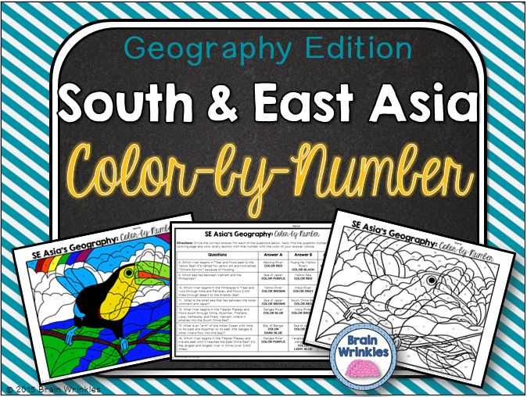
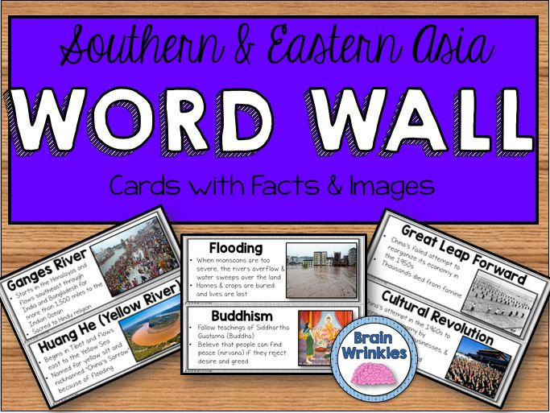
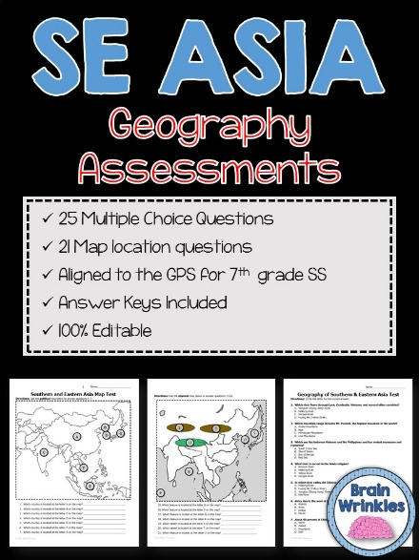

Thank You!
Thank you so much for downloading this file. I sincerely hope you find it helpful and that your students learn a lot from it! I look forward to reading your feedback in my store.
If you like this file, you might want to check out some of my other products that teach social studies topics in creative, engaging, and hands-on ways.
Best wishes,
Ansley at Brain Wrinkles

Slide 60



© Brain Wrinkles. Your download includes a limited use license from Brain Wrinkles. The purchaser may use the resource for personal classroom use only. The license is not transferable to another person. Other teachers should purchase their own license through my store.
This resource is not to be used:
By an entire grade level, school, or district without purchasing the proper number of licenses. For school/district licenses at a discount, please contact me.
As part of a product listed for sale or for free by another individual.
On shared databases.
Online in any way other than on password-protected website for student use only.
© Copyright Brain Wrinkles. All rights reserved. Permission is granted to copy pages specifically designed for student or teacher use by the original purchaser or licensee. The reproduction of any other part of this product is strictly prohibited. Copying any part of this product and placing it on the Internet in any form (even a personal/classroom website) is strictly forbidden. Doing so makes it possible for an Internet search to make the document available on the Internet, free of charge, and is a violation of the Digital Millennium Copyright Act (DMCA).
Thank you,
Ansley at Brain Wrinkles
Terms of Use
Clipart, fonts, & digital papers for this product were purchased from:

